Slide 1
Nature Science Research and Innovation Centre
Ontario (ON), Canada
Online Education (OE) Division
Recipe Development and Menu Planning
Lesson 4
Ms Wonda Grobbelaar (MBA)
Professor of Practice – OE Division
NSRIC Inc.
London, ON, Canada
E-mail: wonda.grobbelaar@gmail.com
https://www.nsric.ca

Slide 2
Class learning outcomes
The student will understand stabilizers and preservatives.
The student will have knowledge about chemicals that might be used in food items.
The student will learn about the different ‘E’ Products.
The student will have knowledge about preservatives in the modern day.

Slide 3
Definition of Food Additives
Food Ingredients are the things that are used to make something, especially all the different foods you use when you are cooking a particular dish.
A food ingredient is any substance that is added to a food to achieve a desired effect.
The term “food ingredient” includes food additives, which are substances added to foods for specific technical and/or functional purposes during processing, storage or packaging.

Slide 4
Definition of a Food Additives (Continued)
A food additive is any substance added to food. For example, low-calorie sweetener aspartame, which is used in beverages, puddings, yogurt, chewing gum and other foods, is considered a direct additive.
Monosodium Glutamate (MSG) to intensify and enhance the flavor of savory dishes. ...
Artificial Food Coloring
Sodium Nitrite
Guar Gum
High-Fructose Corn Syrup
Artificial Sweeteners
Carrageenan
Sodium Benzoate

Slide 5
Two different Types of Food Additives
There are two types of food additives—direct and indirect.
Direct food additives are used in foods to impart specific technological or functional qualities.
For example, stabilizers are used to help prevent separation of nutrients in fortified milk products, while phosphates are used as a leavening agent in baked goods.
Indirect additives are not intentionally added to food but may be present in trace amounts as a result of processing, packaging, shipping or storage.

Slide 6
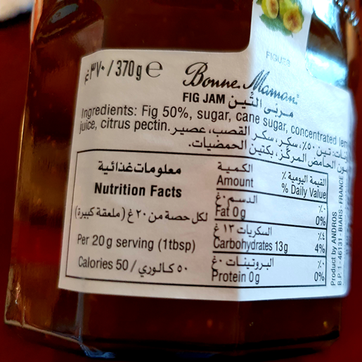
Direct food Additives
Pectin is a food additive that is used as emulsifier, stabilizer and thickening agent.
It is also used as thickening agent and stabilizer that is used in food as food additive.
Pectin is used in jams for the jelly-like appearance.

Slide 7
Pectin
Pectin is a fiber found in fruits.
Pectin is a naturally occurring substance found in berries, apples and other fruit.
When heated together with sugar, it causes a thickening that is characteristic of jams and jellies.
In the past pectin was not used in jams.
Instead, jam was cooked in a pot over a hot stove, stirring until the vitamins were cooked out of it and it finally cooked down to a thicker consistency.
You can also make your own pectin.

Slide 8
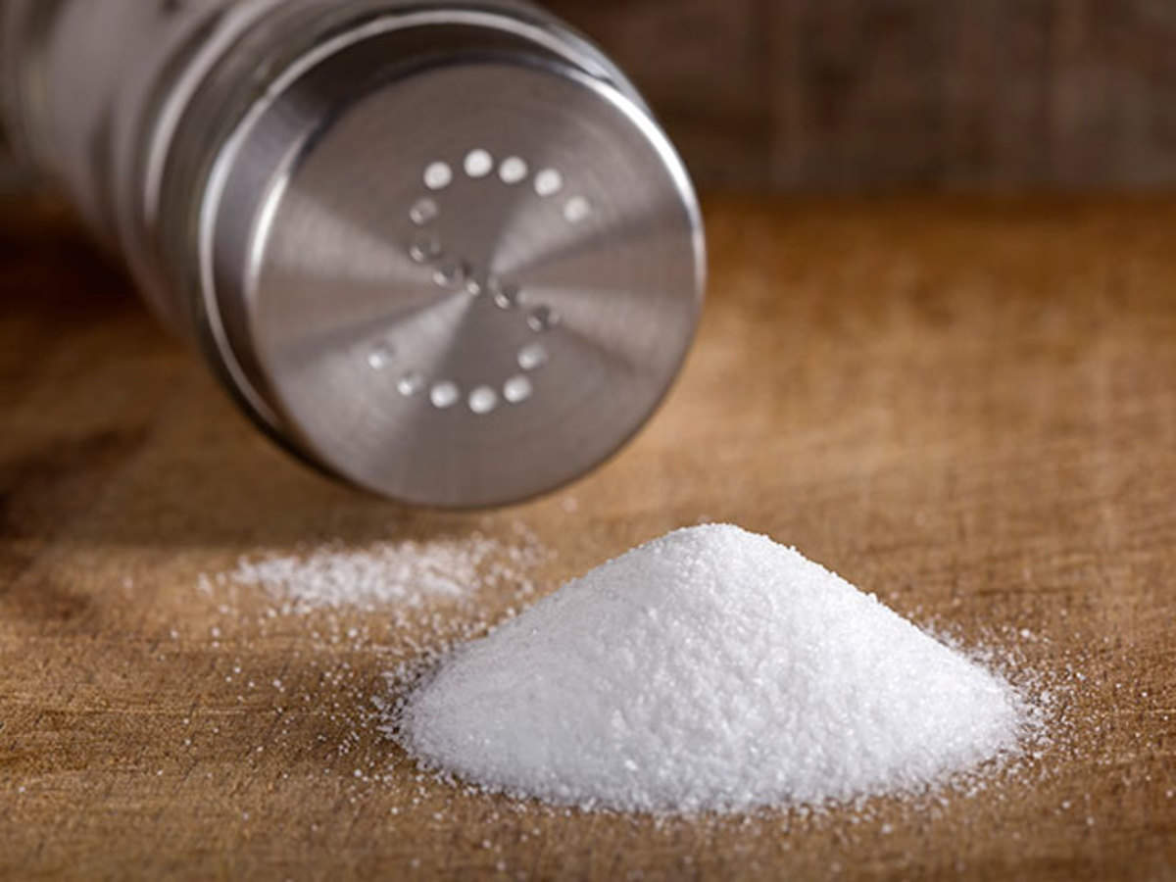
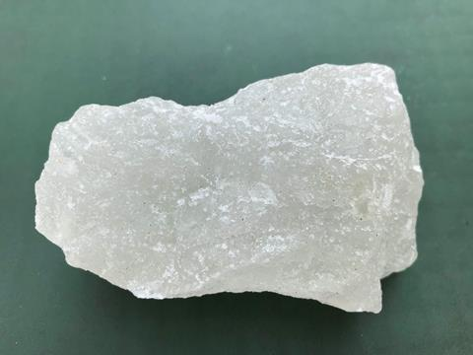
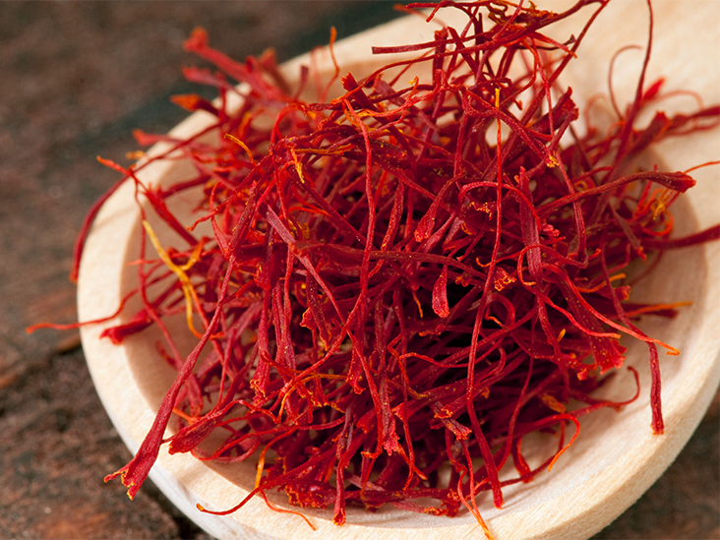
History of Direct Food Additives
Food additives have been used for centuries.
The ancient Romans would use spices such as saffron to give foods a rich yellow color.
Salt and vinegar were used to preserve meats and vegetables for long voyages.
Romans added alum (potassium aluminum sulfate) to bread to make it whiter.

Slide 9
History of Direct Food Additives
In the 1960s, regulators decided to make a standardized list of these additives.
In Europe, these are referred to as E numbers (the E stands for Europe).
In Australia, we just use their code number.
So, vitamin C would be called E300 in Europe.
In Australia, it can be found on labels with the code number 300, such as “food acid 300”, “ascorbic acid (300)” or “vitamin C (300)”.

Slide 10
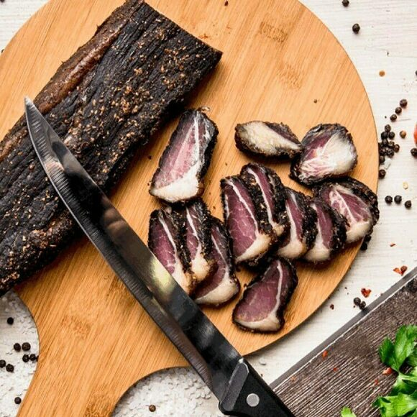
Biltong
Red meat preserved with salt and vinegar.
The meet can be beef, chicken, ostrich and game.

Slide 11
Stabilizers
Stabilizers are an indispensable substance in food items that categorized as food additives.
When added to the food items, they smoothen the texture of the food & give a definite body to the food.
Food stabilizers are added in relatively small amount which aggravate the effect of emulsifiers.

Slide 12
Different types of Stabilizers
Alginate
Agar
Carrageenan
Cellulose and Cellulose Derivatives
Gelatin
Guar Gum
Gum Arabic
Locust Bean Gum

Slide 13
Stabilizers, Preservatives and Human Health
Degraded carrageenan is not safe for humans to eat.
Research has indicated that it causes gut tumors, ulcers, and colon cancer.
Natural preservatives, which are used to preserve food 'as is' are not harmful to your health.
Stabilizers and preservatives are not harmful if they are not mixed with synthetic items and the chemical composition is not altered.

Slide 14
Direct Additives Continued
All are produced synthetically from the respective carbonates and phosphoric acid.
Function & characteristics: Buffers and emulsifiers.
E450 (iii) also binds metals and prevents discoloration due to metals.
E450 (vi) is also used as bread enhancer and calcium supplement.

Slide 15
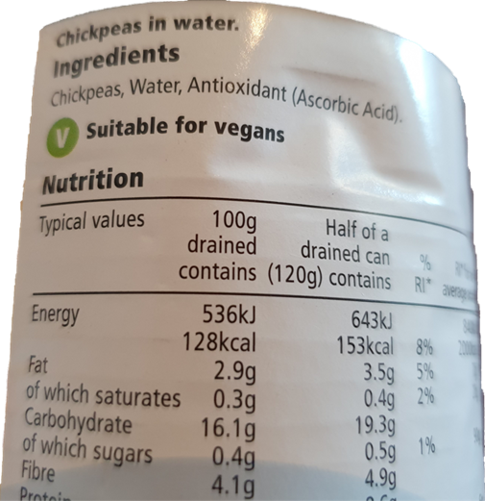
Direct Additives Continued
The ascorbic acid in supplements is often derived from corn starch, corn sugar, or rice starch, and is chemically dependent upon volatile acids.
The method for vitamin C synthesis using two-step fermentation was developed by China in the 1960s:Ascorbic acid production.

Slide 16
Direct Additives (Continued)
E numbers (Food Additives)
E100–E199 (color additives) - (35)
E200–E299 (preservatives) - (29)
E300–E399 (antioxidants, acidity regulators) - (23)
E400–E499 (thickeners, stabilizers, emulsifiers) - (7)
E500–E599 (acidity regulators, anti-caking agents) - (3)
E600–E699 (flavor enhancers) - (7)
E700–E799 (antibiotics) - (9)

Slide 17
Direct Additives (Continued)
100 to 199: Food coloring.
Saffron is “food color 164” in Australia (or E164 in Europe).
Other spices commonly used to add color to foods include turmeric (E100) and paprika (E160c).
200 to 299: Preservatives.
These prevent the growth of microbes in food that might make us sick.
E220, for example, is Sulphur Dioxide, a preservative commonly used in wine to stop acetic acid bacteria from turning the wine into vinegar.

Slide 18
Direct Additives Continued
300 to 399:
Antioxidants. Vitamin C (E300) falls into this category.
400 to 499:
Thickeners, emulsifiers and stabilizers.
Thickeners are commonly used in soups or sauces. Emulsifiers help keep oily substances and watery substances mixed, such as mayonnaise.
Without emulsifiers, the oily and watery part can separate, as seen with vinaigrettes.

Slide 19
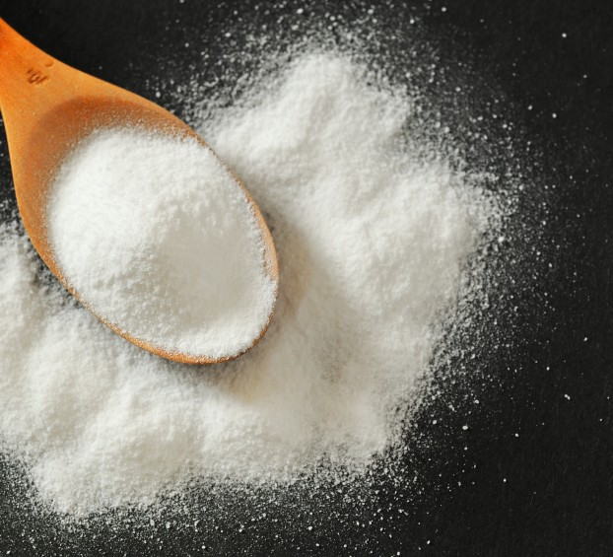
Direct Additives (Continued)
500 to 599:
Acidity regulators and anti-caking agents.
Sodium bicarbonate (E500), commonly known as baking soda or bicarbonate of soda, regulates acidity.

Slide 20
Direct Additives (Continued)
600 to 699: Flavor enhancers, including monosodium glutamate (E621) or MSG.
700 to 999: Sweeteners, foaming agents and the gases used to package foods, such as nitrogen gas (E941).
This is used in most potato chip packaging, as it stops them from oxidizing.

Slide 21
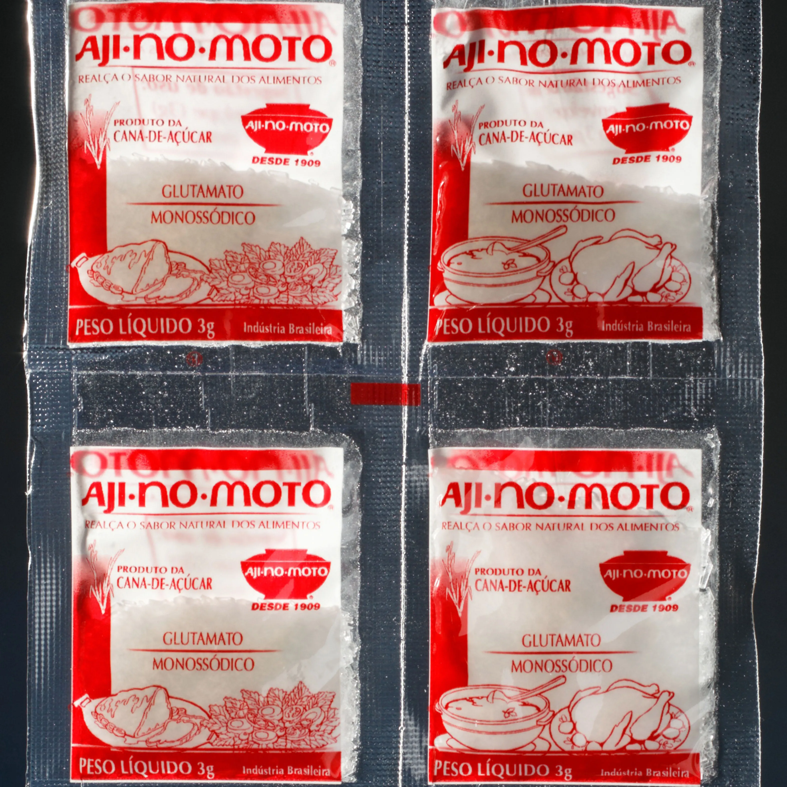
MSG
MSG has been associated with various forms of toxicity.
MSG has been linked with obesity, metabolic disorders, Chinese Restaurant Syndrome, neurotoxic effects and detrimental effects on the reproductive organs.
MSG doesn't exist in nature; it's a scientific invention.
Decide for yourself.
Is it good or bad for your health?

Slide 22
Gasses Used in Packaged Food
Carbon dioxide is used to prevent the growth of mold and bacteria.
It helps to achieve a longer shelf life.
The blend balance of how much carbon dioxide, nitrogen and oxygen will be required to insert into a package is unique to the products being preserved and must be customized accordingly.
Nitrogen is an inert gas. It is normally used during the packaging process to exclude and remove oxygen.
Oxygen is highly-reactive, so this means it likes to combine with other molecules, which results in food spoiling or losing its freshness.

Slide 23
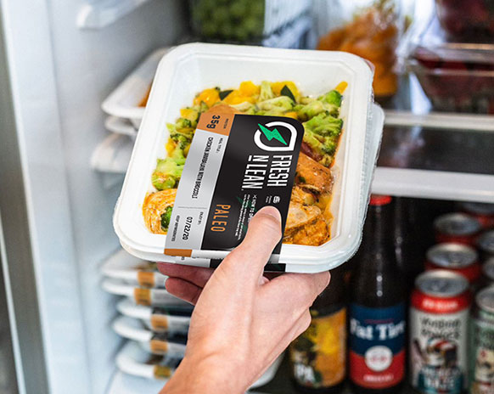
Packaged Food

Slide 24
Regulation of E Numbers
E number restrictions vary between countries, depending on how the local regulatory authorities interpret the product’s toxicity results.
Toxicity is the ability for a substance to cause damage, which is often related to how much of the substance is eaten.

Slide 25
Assignment
Choose 5 products.
The products must be ready to eat. It can be tins of food, prepacked meals or even different juices, cookies or snacks.
Compare at least 3 different brand with each other.
What is the ingredients in every product?
In your opinion, which product out of the 3 different brans will be the healthiest to eat?
Take care to look for any E Product.
Make a list of the E Products and see what is the health-related issues associated with them.

Slide 26
Conclusions
Not all preservatives and stabilizers are unhealthy for you.
Some stabilizers contain chemicals which might be harmful to the body.
As a recipe developer we should always take care to develop the healthiest recipe possible.
Choose your ingredients wisely.
In the next session, we will learn more about different ingredients and food additives.
Thank you for attending this session.

