Slide 1
NSRIC Inc. (Nature Science Research and Innovation Centre)
Ontario (ON), Canada
Online Education (OE) Division
NSRICURA13_1 – Practical Procedures in Testing Software Project(s)
Rasham Majachani
Instructor
NSRIC Inc.
London, ON, Canada
E-mail: rmajachani@gmail.com
Insert Your Picture in the Box
https://www.nsric.ca

Slide 2
Chapter 7_ Testing Practical Approach
ABC Software Testing Process & Procedures

Slide 3
Project Software Testing Approach
This course describes the process by which the Client’s ABC application project will be fully tested.
Testing stages and activities will be defined, along with stage objectives, responsibilities, entry and acceptance criteria, test models, and environments.

Slide 4
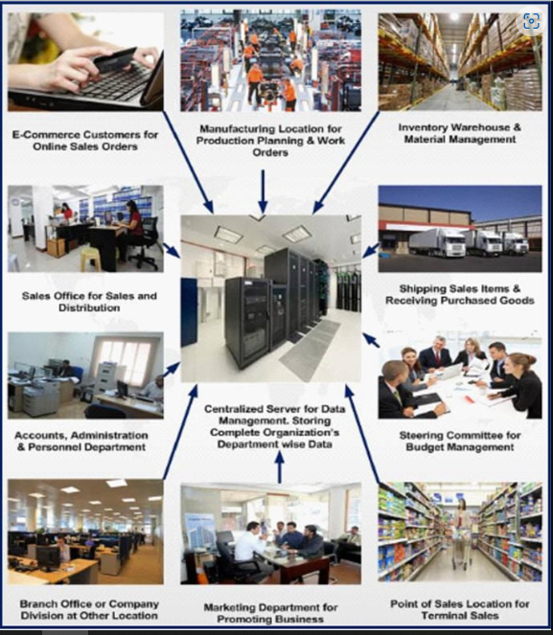
Project Software Testing Approach

Slide 5
Testing Overview
To support processes and functions, the project team will implement the following technologies for ABC Corporation Application
- Controlling (CO)
- Financials (FI)
- Accounts Receivable (AR)
- Accounts Payable (AP)
- General Ledger (GL)
- Fixed Assets (FA)
- Project Systems (PS)
-

Slide 6
Testing Overview cont…
- Material Maintenance (MM)
- Procurement
- Inventory
- Sales and Distribution (SD)
- Management Reporting (BW)
Related business processes
- Environmental projects
- Accounting
- Service Machines

Slide 7
Introduction
Project Test Plan Objectives
The objective of the Test Plan is to ensure the system will successfully process business transactions in accordance with design specifications and the system as a whole functions properly and accurately.

Slide 8
Project Test Plan Objectives
To communicate how testing will be conducted
To identify the major requirements to assure quality system delivery

Slide 9
Still on Introduction
Test Plan Objectives
To document the phases and stages of testing
To document the methods of testing for each stage
To identify the entry and acceptance criteria for each testing stage

Slide 10
Testing will ensure that the current legacy systems (old/ existing systems) will work together with the ABC modules.

Slide 11
The Test Plan must be capable of supporting regression testing; that is, all test cycles should be repeatable

Slide 12
Further testing can be divided into three subcategories or stages:
Unit / Development Test
Integration/ User Acceptance Test
System Test

Slide 13
Testing Schedule/Timeline The testing stages will tentatively be conducted according to the following schedule
Testing Schedule/ Timeline
Date (subject to change)
Unit / Development Testing
System Integration/ User Acceptance Test
System Test
2023 Jan 03
2023 Aug 03
2024 Feb 03

Slide 14
Unit/Development Test
This is the lowest level of testing where the program or transaction is tested and evaluated for errors.
Unit testing will be the first test that is completed during the configuration effort and is focused on the program’s inner functions, rather than on the integration.
Testing focuses on:
Master data
Business processes
Examples: You can test master data by creating a Customer Information

Slide 15
Unit/Development Test cont…
Creating a Sales Order is an example of a basic business transaction in the Sales and Distribution module.
Besides application testing unit testing is also performed during development and even during technical system testing.

Slide 16
Phase 1 - Unit Testing
Unit testing will be performed as part of the baseline/ 1st development and final configuration/ development work packages of the 1st phase of the project
During configuration development, unit testing is done whenever it is needed.

Slide 17
Phase 1- Unit Testing continues
The BPML or Excel tracks the status of the unit testing.
For development testing, a separate tool or spreadsheet will be used to track interfaces, conversions, and enhancements.

Slide 18
Test Documentation
Because unit test concentrates on testing single transactions during the ongoing configuration/ development process there is normally no need to develop detailed test documentation.

Slide 19
Test Documentation continues
For simple transactions, testing can be done straightforwardly during configuration/ development and the results (status T = Tested and any comments) can be recorded in the corresponding Testing Tool or Excel

Slide 20
Test Documentation continues
However, some transactions are very complex involving multiple screens, functions, and variations to run.

Slide 21
Test Documentation continues
Those transactions (e.g. Sales orders) can be documented and tested with a BPP/ excel, maintaining the test section with test conditions and variations of the standard transaction.

Slide 22
Roles
Consultants/ developers configure/develop the system during Baseline configuration/ development and perform unit testing for Baseline.

Slide 23
Roles cont…
During the Final Scope configuration/ development, test/ developing team members learn transactions/ processes and perform some unit testing

Slide 24
System Test Environments
Unit testing is performed in the development system, using a different testing environment.
Development testing will be performed in the development environment.
Therefore, the configuration/ development settings (objects) must be copied to the other environment before testing.

Slide 25
Note …
NO official testing will be done in the sandbox/ training environment – Sandbox is for team members to “play” without the worry of breaking the system.
Lastly, no testing is performed in the configuration/ development environment.
This development environment is the “golden” environment where the configuration/ development is clean and used as the master

Slide 26
Phase 2 - Integration Testing
Purpose:
The purpose of the Integration Test is to verify that all aspects of the technologies work according to the specifications developed in the detailed design
Are properly integrated and ready for production.
The Integration Test focuses on the end-to-end business processes and integration points (interfaces, conversions, and forms).

Slide 27
Integration Testing cont…
Test cycles will be executed according to the test plan and scripts developed during Integration Test preparation.
The cycles simulate the actual business cycles of the new system.

Slide 28
Integration Testing cont…
Integration, scenario, and user acceptance testing will fall under the umbrella of integration testing.
We are going to be condensing these individual phases.
Integration Test 1 – 3

Slide 29
Integration Testing cont…
Final Integration testing will be done in three iterations.
The first iteration (Integration Test 1) concentrates on testing all important business processes inside our main application system
Starting with touch-point scenarios and ending with end-to-end scenarios.
Master data conversions will also be included in this cycle. Superuser roles will be used for security testing.

Slide 30
Integration Testing cont…
Integration Test 2, as a second iteration, focuses on the most important cross-enterprise scenarios with touchpoints to external components
This includes testing of conversions, interfaces, reports, forms, and the necessary authorizations.
Functional/ power user roles of the application will be used for security testing.

Slide 31
Integration Testing cont…
Integration Test 3 will include other testing required as testing progresses.
Functional end-user roles will be used for security testing.

Slide 32
Prerequisites
Testing Team
A testing team will be assembled that will test all or part of the application scenario.
It is important to bring the right personnel together to ensure a thorough test is performed.

Slide 33
Prerequisites cont…
Subject matter experts, business experts, and technical experts will be the foundation of the team.
End users are an important piece of the team.

Slide 34
Role Major Responsibility
Testing Coordinator
Scenario test leader/owner
Tester (team member)
Provides the testing environment and process
Usually the core team lead. Provides leadership for the individual team performing the integration tests for a specific scenario.
Performs the test and logs results. Including defect documentation

Slide 35
Role Major Responsibility
Functional Analyst
Developer
Provides functional/business support and works on defects
Provides technical support and works on defects

Slide 36
Test Data Model
A data model will be in place prior to integration testing.
The core teams will provide the necessary data for the model.
It is expected master data will be loaded through conversion efforts prior to testing.

Slide 37
Test Data Model cont…
The conversion group will ensure the data is loaded in the correct sequence prior to testing.
The following questions need to be answered to assist in building the test data model:

Slide 38
Questions cont…
What are the master data requirements?
What data needs to be in the system prior to testing?
Is there specific date-related data required?
What data needs to be present to ensure the scenario being tested is successful?

Slide 39
Integration Testing Completion Success Criteria

Slide 40
It is vital to determine prior to entering into the integration testing phase what criteria define the end of integration testing.
When this criterion is met, the testing phase is over. Before entering into the integration testing phase, it is vital to determine

Slide 41
Business Scenarios
All scenarios are to be defined prior to entering into integration testing
However, it is expected that some scenarios may be created during testing due to the complexities of some business processes that may have been overlooked during preparation.

Slide 42
Scenarios cont…
Priorities will be set on each scenario in terms of high, medium, and low.
The high-priority scenarios must be tested to a specified satisfaction level.
Medium-priority scenarios will be fully considered, while low-priority scenarios will be tested as time permits.

Slide 43
Scenarios cont…
Also, the variations of scenarios will be prioritized into high, medium ad low categories.
Again, integration testing cannot last longer than the Integration Testing Completion Criteria; thus, all scenarios may not be tested.

Slide 44
Scenarios cont…
The priority of a scenario may be a factor in the completion criteria.
Furthermore, the level of negative testing (entering incorrect data) may be minimal due to these constraints.

Slide 45
The Process
Summary
All integration test scenarios are to be identified.
After each script is executed, test results will be compared to previously prepared expected results.

Slide 46
The Process cont…
Summary
Any discrepancies between the Integration Test results and the expected results generated from the design specifications are logged, researched, corrected, and retested.
Priorities (High, Med, Low) will be assigned to all discrepancies to ensure critical problems are validated and corrected first.

Slide 47
Detail
The following flow diagram depicts the main steps for a typical scenario to be tested.

Slide 48
Scenario/Test Script Creation Process

Slide 49
Scenario Test Process

Slide 50
Integration Testing Tools
Tools:
Scenario list
Test scripts
Defect tracking
The QA (Quality Assurance database)
Document:
Metrics schedule
This document
Defect documentation

Slide 51
Integration Testing Tools cont…
Defect tracking
Defect documentation
Defect/ Issue log
Statistics
Test procedure

Slide 52
Business Scenario List
Testing scenarios are the focal point of integration testing.
These business processes are initially defined at a very high level and are broken down into sub-scenarios and further to transactions within application/ software.

Slide 53
Scenario List cont…
External processes (interfaces, conversions, etc.) are included in the scenarios during test 2 of the integration phase.
The scenario list will be gathered and captured in the overall test plan

Slide 54
Test Scripts
Test scripts include the step-by-step procedure to test a specific test business scenario.
In our integration testing we will use a template listing the steps Business process procedures (BPP) will be attached to the test script to provide the step-by-step procedure.

Slide 55
Test Scripts cont…
It is assumed BPPs would have been tested for accuracy during the unit testing phase.
However, if an error in BPP is identified, it will be corrected and the training team is to be notified.

Slide 56
Test Scripts cont…
The script will also include the expected result of each part of the scenario
Any deviation from the expected result will result in a system investigation request.

Slide 57
Defect Tracking
A defect log will be used to capture defects as they arise.
These Word documents will allow the tester to document the defect in a way that will be helpful to the functional or technical personnel that will be resolving the defect.
Screenshots, error messages, etc. are a few of the elements that will be put in the log.

Slide 58
Defect Tracking cont…
Defect log files will be kept in soft and hard copies.
A scenario file will be kept in the testing lab will all related documentation.
All defects will be logged into the issues database for storage and reporting.

Slide 59
Defect Tracking cont…
An integration testing tracking document has been developed to track each scenario/test script.
It will track the development, status, owner, defect/issue information, and pertinent dates.

Slide 60
Statistics
For reporting purposes, metrics will be tracked to provide information on the status of integration testing.
Elements will include the number of scenarios, complete passes, failures, defects, open and resolved issues, etc.

Slide 61
Testing Procedures
All participants in integration testing must follow specific procedures.
This document has been developed to contain these procedures, including “how to”, naming conventions, file locations, etc.

Slide 62
Testing Process Setup and General Guidelines
Preliminaries
Master Data conversion process complete, including review, and in the environment (QA) e.g. 310
All other data required for testing, as identified by the core teams, in the environment e.g. 310

Slide 63
Testing Process Setup and General Guidelines cont…
Preliminaries
Security has been established in the environment e.g. 310 for all testers (cycle 1 – core teams, Cycle 2 – include end users)
Review existing requests for transports to environment QA e.g. 320 by all team members

Slide 64
Cont…
Sign off on readiness for environment QA. e.g. 310 by the PMO and technical team
Stop automatic transports to environment QA (includes e.g. environment 310)

Slide 65
Cont…
Lockdown/freeze changes in environment QA e.g. 310
Backup in environment QA e.g. 310

Slide 66
Cont…
Success Criteria reviewed by project management with executive approval
Scenarios ready for testing (at least high priority)
The scenario owner (one from Client and Consulting team) identified
Scenario teams identified

Slide 67
General Guidelines
A typical day in integration testing (subject to change)
Testing teams can test anytime during the 5 weeks of testing (labs will be available 24 hours/day).
However:
Dedicated testing will take place between 9:00 am and 4:00 pm, Monday to Friday

Slide 68
General Guidelines cont…
A typical day in integration testing (subject to change)
Do not schedule meetings and other work during this time that will conflict with testing.
Be prepared to participate in testing activities per the daily testing schedule
Defect handling will run concurrently with testing

Slide 69
General Guidelines Cont…
A typical day in integration testing (subject to change)
A review/status/action meeting will be scheduled from 4:00 pm to 5:00 pm each day in test lab 1 (4th-floor ABC)
A floating schedule concept will be used
All scenarios will be ordered (generally based on priority)

Slide 70
General Guidelines Cont…
A typical day in integration testing (subject to change)
A number of scenarios will be selected for testing each day (based on complexity)
This number may be adjusted, during the day, based on the expediency of testing

Slide 71
General Guidelines Cont…
A typical day in integration testing (subject to change)
Example: if 5 are scheduled and are executed and completed (failed OR passed) and there is testing time remaining, the next scenario(s) in order will be tested.
Each scenario team member must be present in the testing lab during the time of execution

Slide 72
General Guidelines Cont…
A typical day in integration testing (subject to change)
The support team members will be on “standby” for issues resolution while testing is being executed

Slide 73
General Guidelines Cont…
A typical day in integration testing (subject to change)
A status/scenario schedule will be posted at least once per day including:
The status of each scenario

Slide 74
General Guidelines Cont…
A typical day in integration testing (subject to change)
What is scheduled to be tested?
Scenario team members (when known)

Slide 75
General Guidelines Cont…
A typical day in integration testing (subject to change)
Data management within the environment QA
No configuration changes until the first pass of baseline scenarios complete
OR make controlled changes based on review/status/action meeting

Slide 76
The Testing Protocol (Execution)
Inputs/Preparation
Scenario document (test case)
Set up data
Expected results consistent with the specified set-up data
Roles (not binding for Cycle 1)

Slide 77
The Testing Protocol (Execution) cont…
Inputs/Preparation cont…
IDOC verification spreadsheets
Current BPPs/ Excel (which include the transaction steps of the test scenario)
Scenario testing lead ensures all required set-up data is available in client 310

Slide 78
The Testing Protocol (Execution) cont…
Inputs/Preparation cont…
All assigned participants, including Client personnel and appropriate consultants, must be present

Slide 79
The Testing Protocol (Execution) Cont…
Procedure
Save a copy of the master scenario document with a suffix including the date of the test execution (ex: ITS_01_A1 08-27-02.xls)
If the test must be re-executed later from the beginning, create and use a copy of the previous document with a modified suffix (ex: re-test, same day ITS_01_A2 08-27-02.xls)
Capture all document numbers produced in each step

Slide 80
The Testing Protocol (Execution) Cont…
Procedure
Record suggested changes to Business Process Procedures (BPPs) directly on the BPP
For each step: If actual results match the expected results, enter “OK” in the “OK/Error” column.
In this case, the actual results need not be captured in the document.

Slide 81
The Testing Protocol (Execution) Cont…
Procedure
For each step: If actual results do not match expected results, enter “Error” in the “OK/Error” column.
In this case, the defective actual results must be captured in the “Actual results” column.

Slide 82
Procedure Cont…
The client test lead for the scenario has the final say on the severity level.
Defective results with severity levels 1-2: terminate the test
Defective results with severity levels 3-5: test may be continued at the discretion of scenario testing lead

Slide 83
Procedure Cont…
The client test lead for the scenario has the final say on the severity level cont...
Once a test has begun, no changes are permitted to the scenario document.
If changes are deemed necessary by the test execution team, the scenario document should be returned to the scenario development team for modification.

Slide 84
Procedure Cont…
The client test lead for the scenario has the final say on the severity level cont...
Minor corrections should be noted on the paper document by the execution team.

Slide 85
Procedure cont…
The client test lead for the scenario has the final say on the severity level cont…
Defect tracking (outside the scenario document)
A Word document (file name example: ITS_01_A1_Defects.doc) will be used to capture defects as they arise.

Slide 86
Procedure Cont…
The client test lead for the scenario has the final say on the severity level.
Cont...
These forms will allow the tester to document the defect in a way that will be helpful to the functional or technical personnel that will be resolving the defect.
Screenshots, error messages, step numbers, and severity levels are a few of the elements that will be put in the document.

Slide 87
Procedure Cont…
The client test lead for the scenario has the final say on the severity level cont…
This document will be kept in soft and hard copies.
A scenario file will be kept in the testing lab with all related documentation.
All defects will be logged into the QADB issues database for storage and reporting.

Slide 88
Procedure Cont…
The client test lead for the scenario has the final say on the severity level cont…
A test scenario (and each variant within the scenario) is passed when each step of the scenario/variant has been executed and there are no “OK/Error” entries in that scenario/variant column that violate the criteria in the “Success Criteria” document.

Slide 89
Procedure Cont…
The client test lead for the scenario has the final say on the severity level cont...
An integration testing tracking document has been developed to track each scenario/test script.
It will track the development, status, owner, defect/issue information, and pertinent dates.

Slide 90
Procedure Cont…
The client test lead for the scenario has the final say on the severity level.
Cont...
Its location is: H:\EDS ABC Implementation\Integration Testing\Test Planning\Master Scenario List.xls.
Update access to this document will be limited to key testing lead personnel.

Slide 91
Outputs
List of Defects
Passed
Scenario document (hard copy) signed by each Client person assigned to the execution of the test

Slide 92
Outputs conti….
Scenario document (soft copy), filed in the folder: H:\EDS ABC Implementation\Integration Testing\Test Results\Integration Testing\Completed Tests
All related documents (hard copy) should be filed in the main folder for the test:

Slide 93
Outputs cont…
Signed scenario document
Defect document
BPPs updated
Copies of BPPs with handwritten changes were provided to RWD for update

Slide 94
User Acceptance Test
The purpose of the User Acceptance Test is to allow the future users of the Application to verify the system meets all necessary business needs and works as outlined in the Business Blueprints/ ”Business Requirement Document”.

Slide 95
User Acceptance Test cont…
This test serves as a formal sign-off and approval of the ABC application.
The Client users will execute the User Acceptance Test within the integration-testing phase

Slide 96
System Test
System testing consists of technical tests and performance-related tests.
The technical tests aim to validate that the technical components of the production environment are working properly.

Slide 97
System Test cont…
These tests include validating the system administration procedures, failure recovery, and disaster recovery.
The performance-related tests include volume and stress testing of business transactions and business transaction input/output using printer and fax devices.

Slide 98
Technical Test
Failure Test
Disaster Recovery Test
Backup and Restore the Test

Slide 99
Technical Test Cont…
System Administration Test
Printing and Fax Test
Going Live Check

Slide 100
Performance Test
Volume Test
Stress Test

Slide 101
Performance Test cont…
Batch cycle test
Month/quarter/year-end processing

Slide 102
Note that…
Technical tests are rather basis oriented, whereas performance tests cover basis and application aspects.

Slide 103
Note that…
Performance tests should concentrate on a stress test, i.e. stressing the system with all components involved in certain scenarios until it performs to predefined values (throughput).

Slide 104
Note that…
Volume testing is needed for some processes or transactions if the throughput of one process/transaction has to meet predefined requirements (i.e. creating large amounts of sales orders, daily interfaces, etc.)

Slide 105
Roles
Technical Team Lead (along with application team members).

Slide 106
System Testing
Testing will be prepared in the Quality Assurance system but must run on the Production system.

Slide 107
Testing Environment
See Appendix A for a description of the various database environments to be used during the testing phases for the ABC application

Slide 108
Unit Testing Environment
For example;
The 200 series development databases envt. will be used for the unit (210 environments) and development (220 environments) testing.

Slide 109
Integration Testing Environment
The 300 series quality assurance databases – the environment will be used for integration testing.
Instance 310 will be the primary integration testing database instance.
However, as integration testing progresses there may be a need to create other instances (environment) to ensure data integrity is maintained.

Slide 110
Configuration changes (Change Control)
Configuration changes will occur during the integration testing phase.
This is due to continued development and resolution of defects.

Slide 111
Configuration changes (Change Control) cont…
It is imperative to manage the introduction of configuration changes during integration testing.
A process will be developed to ensure controls are in place to prevent configuration changes from negatively impacting integration testing.

Slide 112
Configuration changes (Change Control) cont…
During the daily status meetings within the integration testing phase there will be decisions made on what changes will be moved into the QA environment.

Slide 113
Procedures
This section includes procedures for the following integration testing areas:
Documentation Standards
- Individual Folders & Content
Network Folder Setup
Naming Conventions
Daily Execution Schedule and Status

Slide 114
Documentation
Each scenario will require specific documentation.
This documentation will be kept in a folder located in the testing lab.
The following documents need to be in this folder prior to the integration test of the scenario:

Slide 115
Business process flow (If available)
These documents describe in diagram format a business process.
There can be a series of diagrams that make up a process.
Each diagram can be converted into a testing scenario.

Slide 116
Business process flow (If available) cont…
The diagrams can be hand drawn or developed using a tool such as Word or Visio.
The intent of the process flow diagram is to identify all the steps in a process, where the steps integrate with other areas (ABC product), and what other areas are impacted by the steps of the process.

Slide 117
Business Process Procedure (BPP) cont..
The BPPs are used as the procedures for testers to use during integration testing.
Each testing scenario identifies the transactions that need to be executed.
Each transaction code is BPP.

Slide 118
Business Process Procedure (BPP)
Testing may determine that BPPs need to be modified.
In such cases, an issue will be created to ensure the BPP is modified.
The training team is to be notified at this time to make appropriate changes in the training process.

Slide 119
Scenario/Test script
Integration scenarios and test scripts are the main tools used for integration testing.
The scenario and related script detail the test being carried out.

Slide 120
Scenario/Test script cont…
The steps, transaction codes, testing data, and expected results are vital parts of the scenario.
A specific document will detail this data.
All scenarios will be organized in the integration testing directory.
Insert a diagram here

Slide 121
Test results
Screenshots of each panel
As each scenario is being tested screenshots are taken to track the progress of the test.
This way an audit trail of each integration test is available for analysis purposes.
Insert a diagram here

Slide 122
When defects occur
Each defect that is encountered needs to be documented.
Along with screenshots, each defect will have supporting information to provide as much detail as possible for the functional/technical staff to resolve the defect.
Insert a diagram here

Slide 123
Any other documentation that supports the testing of the scenario

Slide 124
Network Directory Structure
The following structure will be in place to store all the documentation for integration testing:

Slide 125
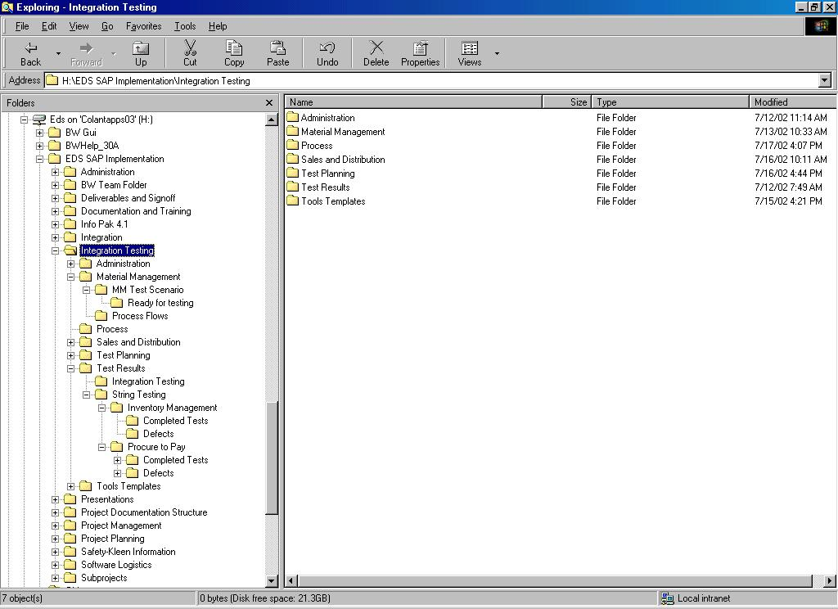

Slide 126
Naming Conventions

Slide 127
 | Element |  |  | Convention |  |  | Example |  |  | Comments
Scenario/Test Script |  |  | ITS_01_A.xls |  |  | ITS_01_A_date |  |  | The description for this
Doc. |  |  | Where: |  |  |  |  |  | scenario will be kept on
 |  |  | ITS_ = constant |  |  |  |  |  | the scenario master list
 |  |  | 01 = Numeric counter
 |  |  | A = constant
 |  |  | Date = date of execution
 |  |  | .xls = Excel file
Defects |  |  | Same as scenario plus |  |  | ITS_01_A –
 |  |  | Defect_date Word file) |  |  | defect.DOC
Business Process Flows |  |  | description.vsd or description.ppt |  |  | GSOD |  |  | Not everyone has Visio
 |  |  |  |  |  | Procurement |  |  | so the creation of
 |  |  |  |  |  | Service.vsd or |  |  | business flows can be
 |  |  |  |  |  | GSOD |  |  | using any tool or even
 |  |  |  |  |  | Procurement |  |  | hand written.
 |  |  |  |  |  | Service.vsd

Slide 128
Daily Execution Schedule and Status
Introduction:
The Integration Testing activities will be continuously managed on a daily basis.
To achieve this, a daily execution plan will be utilized and reviewed by all the lead testers, both the Client and consulting team, every afternoon (Monday through Friday) at 4:00 pm in the Test Lab.

Slide 129
Daily Execution Schedule and Status cont…
The daily execution schedule encompasses a spreadsheet.
The “Day to Day Plan Master” spreadsheet contains the master schedule for all testing.
The “Daily Schedule” spreadsheet contains a schedule of events for the next day or 2.
INSERT DIAGRAM HERE

Slide 130
Procedure Steps:
The following procedures are intended to facilitate the daily execution and status reporting of testing
The Testing Coordinators are responsible for updating the “Day to Day Plan Master” and “Daily Schedule” spreadsheets on the H drive.
The Test Team Members can view these files on the H Drive.
The Scenario owners are responsible on a daily basis for reviewing the Day to Day Plan Master and Daily Schedule plans and providing any updates/changes to the testing coordinators.

Slide 131
Procedure Steps: cont…
A daily 4:00 p.m. testing status meeting will be held to discuss the following:
Explain the schedule for the day
Review any test data needs for the day
If needed, adjust the testing schedule based on open defects
Open discussions on related issues

Slide 132
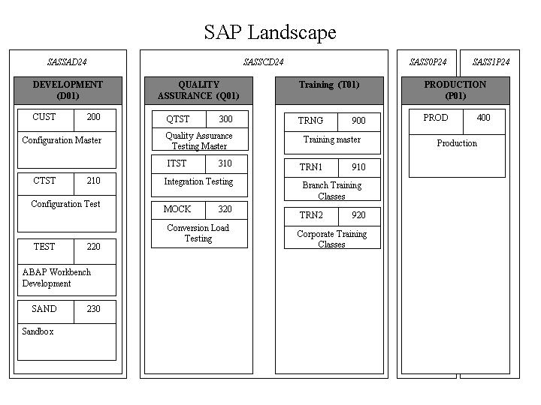
Appendix A – Database Landscape

Slide 133
Exam

