Slide 1
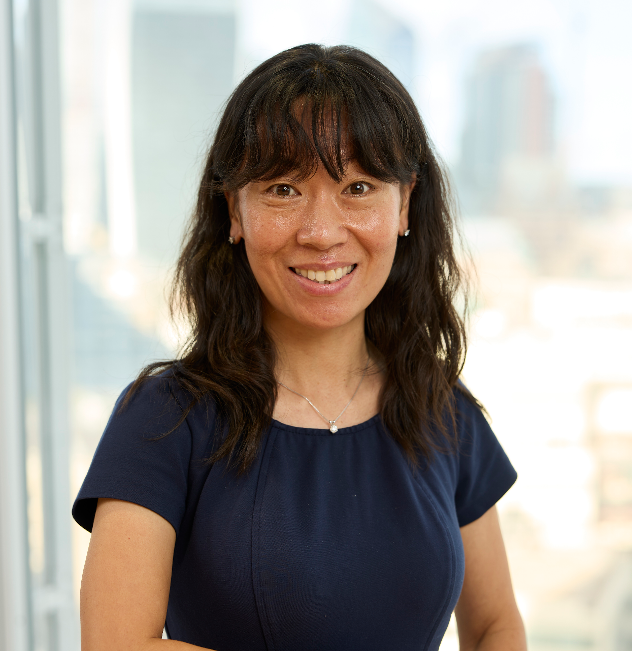
NSRIC Inc. (Nature Science Research and Innovation Centre)
Ontario (ON), Canada
Online Education (OE) Division
Essentials of Marketing
Instructor: Kathy Chen
Marketing Program, OE Division
NSRIC Inc.
London, ON, Canada
E-mail: kathyjchen18@gmail.com
https://www.nsric.ca

Slide 2
Week 9: Promotion and 6Ms
Content covered in this week:
6.1 What is promotion?
6.2 Target market
6.3 Mission

Slide 3
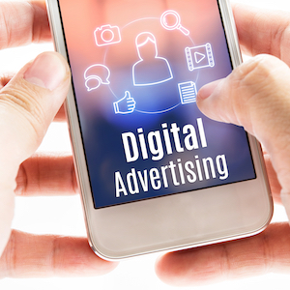
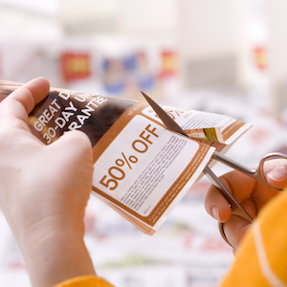
Week 9: Promotion and 6Ms
6.1 What is promotion?
There are two key features of promotions:
Promotions create value.
Promotions communicate value.
Communicating value
Promotions can communicate value through, for example, advertising, public relations, social media marketing and direct marketing.
Creating value
Promotions which create value are about giving incentives to customers. Some examples of this are discounts, rebates, vouchers or coupons, price bundling and loyalty program.

Slide 4
Week 9: Promotion and 6Ms
6.1 What is promotion?
Discounts
Listen to your instructor to discusses a key feature of promotion: discounts
In the following graph, it shows the percentage of demand change in the frozen juice category, compared to the percentage of frozen juice with sales signs. We see from the graph that when the sale signs percentage is between 20 - 30 per cent, demand is at its maximum. However, when the percentage of sale signs goes beyond 30 per cent, we see that demand starts to decline.

Slide 5
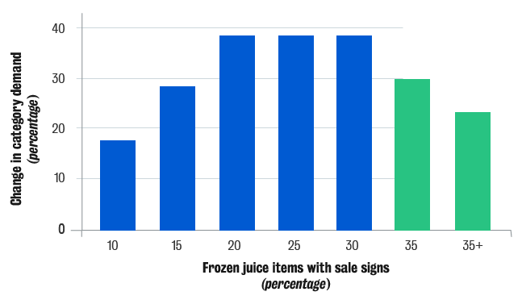
Week 9: Promotion and 6Ms
The main message of this graph is that while creating value for customers is a great idea, firms should not overdo it. Too many discounts or sales will decrease the number of purchases. Reasons for this might be that people will stock up, or they will become more price-sensitive and/or less brand-loyal. Therefore, the firm will be worse off by overdoing the incentive part of promotion to customers.

Slide 6
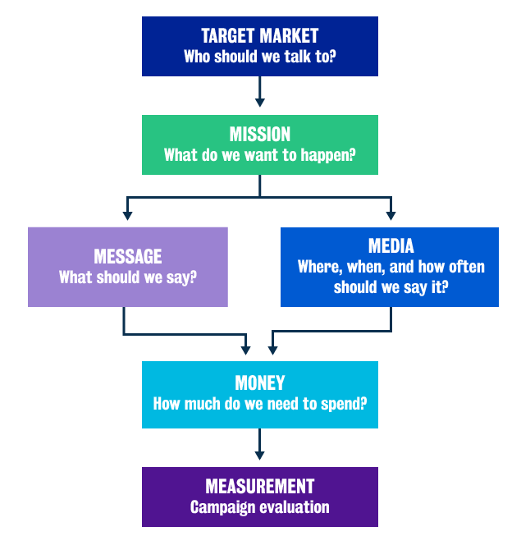
Week 9: Promotion and 6Ms
6.1 What is promotion?
The 6Ms
Target market: whom should we target through our communication?
Mission: what do we want to happen?
Message: what should we say?
Media: where, when and how often should we say it?
Money: how much money should be spent on it?
Measurement: what is the best way to measure whether or not the promotion is working?

Slide 7
Week 9: Promotion and 6Ms
6.2 Target market
1. Who makes up our target market?
Customers
It goes without saying that customers are a target and most of
us, as customers, have seen advertising and other means of
promotion.
Channel partners
As advertisers, we must also communicate to our channel partners because these are the parties in the distribution network that will help sell our products and promote them in turn to the final consumer.
Influencers
The third group we want to consider in the more modern social media world are influencers. We have always had opinion-leaders talking about our products, but influencers have become more ubiquitous in the social media/digital world and, therefore, firms also need to communicate to these influencers.

Slide 8
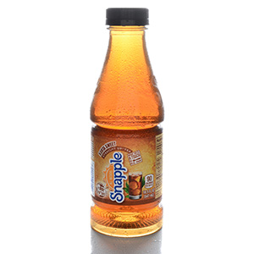
Week 9: Promotion and 6Ms
6.2 Target market
2. Channel partners
Snapple was a small drinks manufacturer and iced tea
was a new product for them. The firm did not have a
large promotion budget, however, it intelligently used its
channel partners to promote its product. It did this by
going to petrol stations in different parts of the US and
stocking the beverage refrigerators with Snapple iced
tea. Many customers picked up Snapple in these petrol
stations, and thus, this was a very successful promotion.
Once Snapple’s promotion took off, the product was launched full-time in grocery stores, and afterwards, Snapple became a big name. What Snapple did was to cleverly use channel partners to communicate its existence and thereby create brand awareness, persuading customers to buy its product.

Slide 9
Week 9: Promotion and 6Ms
6.2 Target market
3. Influencers
Colin Kaepernick
In this video, Nike, the sports firm, used Colin Kaepernick, an American footballer in the United States, to promote their brand. Kaepernick was a controversial choice because he had decided to kneel down during the US national anthem instead of standing up(opens in a new tab). As you watch the video, think about why Nike chose this style of video, and also think about their choice of Colin Kaepernick as an ambassador.

Slide 10
Week 9: Promotion and 6Ms
6.2 Target market
3. Influencers
What is the impact of this video?
By using Kaepernick, it created a buzz, which seemingly worked, as sales were considered to have increased after this advertisement was aired. Take away: use an appropriate influencer/endorser.
Mark Machado
Nike also uses a well-known LA tattoo artist, Mark Machado (‘Mister Cartoon’), to advertise its Cortez line of shoes. Machado is iconic with the Hispanic and Latino population in the United States. Nike used him to promote their products even before digital media was around and continues to do so. Visit the website to the Nike promotion(opens in a new tab).

Slide 11
Week 9: Promotion and 6Ms
6.2 Target market
3. Influencers
Other influencers
The following links take you to articles about influencers. They show how these people, who are otherwise everyday people (they are not celebrities in the regular sense, such as actors or sports personalities) have become very important in the promotion schemes of many firms. Influencers can make a lot of money doing this type of promotion.
Medium: The Hyper-Influencer(opens in a new tab)
SCMP: Who are China's top influencers and key opinion leaders by commercial value?(opens in a new tab)
CNBC: From Lu Han to Papi Jiang, Chinese celebrities are making a lot of money from social media

Slide 12
Week 9: Promotion and 6Ms
6.3 Mission
1. What are our objectives?
What are the major objectives of communications?
Objective 1: creating awareness
Building awareness in consumers’ minds is about informing the customer or potential customer about the existence of the product. If a person does not know that the product exists, why would they even consider it? We know that if a product is not considered, the consumer is unlikely to buy it.
Objective 2: creating associations
If a person uses a product, when they see a communication about that product they will be reminded of the satisfaction and positive attitudes and feelings that they have towards the product. Creating those memories and reminding people about them brings the product into salience in the consumer’s mind.

Slide 13
Week 9: Promotion and 6Ms
6.3 Mission
1. What are our objectives?
What are the major objectives of communications?
Objective 3: encouraging action
In many cases, communications are about developing a motivation to act. This is essentially about telling people to go and buy the product.
The first two objectives described above tend to build long-term brand equity. This means that marketing communication efforts help the brand to strengthen its image and awareness, etc. The third objective is more short-term and relates to sales.

Slide 14
Week 9: Promotion and 6Ms
6.3 Mission
2. AIDA (awareness, interest, desire, action)
The graphic shows different types of promotion and their effectiveness in creating awareness, in capturing people’s interest and in inciting people’s desire for the product so that they finally act to purchase the product. ‘Awareness’, ‘interest’, ‘desire’ and ‘action’ can be shortened to the acronym ‘AIDA’. The graphic shows a general schematic with multiple categories over time, but note that the structure will not be exactly the same for all categories of products.

Slide 15
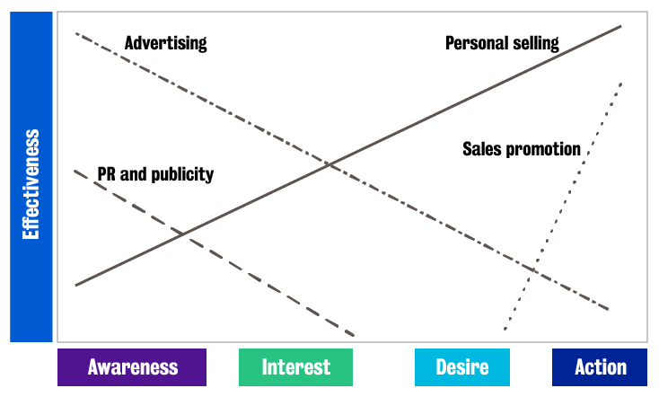
Week 9: Promotion and 6Ms
6.3 Mission
2. AIDA (awareness, interest, desire, action)

Slide 16
Week 9: Promotion and 6Ms
6.3 Mission
2. AIDA (awareness, interest, desire, action)
What does the graphic tell you about the effectiveness of each type of promotion in generating awareness, interest, desire and action?
The graphic shows that advertising is excellent at creating awareness and interest, but it is not so good at inciting action. Sales promotions (monetary promotions) are very good for encouraging consumers to purchase. Sales promotions do not increase awareness of the product, but if a person sees a sale they might go and buy something, hence it is better for ‘action’. Personal selling is also good for ‘action’. Remember from our previous topics that personal selling is when one-to-one reps of a particular company try to sell a product. Personal selling does create some awareness and interest, but it is most effective in actually making a sale. PR and publicity create awareness and interest but have very little effect on actual purchases.

Slide 17
Week 9: Promotion and 6Ms
6.3 Mission
2. AIDA (awareness, interest, desire, action)
What does the graphic tell you about the effectiveness of each type of promotion in generating awareness, interest, desire and action?
The graphic shows that advertising is excellent at creating awareness and interest, but it is not so good at inciting action. Sales promotions (monetary promotions) are very good for encouraging consumers to purchase. Sales promotions do not increase awareness of the product, but if a person sees a sale they might go and buy something, hence it is better for ‘action’. Personal selling is also good for ‘action’. Remember from our previous topics that personal selling is when one-to-one reps of a particular company try to sell a product. Personal selling does create some awareness and interest, but it is most effective in actually making a sale. PR and publicity create awareness and interest but have very little effect on actual purchases.

Slide 18
Week 9: Promotion and 6Ms
6.3 Mission
3. Social media
This table shows a snapshot of social media metrics by purpose. It is reproduced from the following article: Hoffman, D.L and Marek, F. (2010). Can you measure the ROI of your social media marketing? Sloan Management Review, 52(1).

Slide 19
Week 9: Promotion and 6Ms
Social media application | Brand awareness | Brand engagement | Word of mouth
Blogs | Number of unique visits Number of return visits Number of times bookmarked Search ranking | Number of members Number of RSS feed subscribers Number of comments Amount of user-generated content Average length of time on site Number of responses to polls, contests, surveys | Number of references to blog in other media (online/offline) Number of reblogs Number of times badge displayed on other sites Number of ‘likes’
Social bookmarking (eg StumbleUpon) | Number of tags | Number of followers | Number of additional taggers

Slide 20
Week 9: Promotion and 6Ms
Social media application | Brand awareness | Brand engagement | Word of mouth
Microblogging (eg Twitter) | Number of tweets about the brands Valence of tweets (+/-) Number of followers | Number of followers Number of @replies | Number of retweets
Co-creation (eg NIKEiD) | Number of visits | Number of creation attempts | Number of references to project in other media (online/offline)

Slide 21
Week 9: Promotion and 6Ms
Social media application | Brand awareness | Brand engagement | Word of mouth
Forums and discussion boards (eg Google Groups) | Number of page views Number of visits Valence of posted content (+/-) | Number of relevant topics/threads Number of individual replies Number of sign-ups | Incoming links Citations in other sites Tagging in social bookmarking Offsite references to the forums or its members In private communities: number of pieces of content (photos, discussions, videos); chatter pointing to the community outside of its gates Number of likes

Slide 22
Week 9: Promotion and 6Ms
Social media application | Brand awareness | Brand engagement | Word of mouth
Product reviews (eg Amazon) | Number of reviews posted Valence of reviews Number and valence of other users’ responses to reviews (+/-) Number of wish list adds Number of times product included in users’ lists (ie Listmania on Amazon.com) | Length of reviews Valence of reviews Valence of other users’ ratings of reviews (ie how many found particular reviews helpful) Number of wish list adds Overall number of reviewer rating scores entered Average reviewer rating score | Number of reviews posted Valence of reviews Number and valence of other users’ responses to reviews (+/-) Number of references to reviews in other sites Number of visits to reviews site page Number of times product included in users' lists (ie Listmania on Amazon.com)

Slide 23
Week 9: Promotion and 6Ms
Social media application | Brand awareness | Brand engagement | Word of mouth
Social networks (eg Bebo, Facebook, LinkedIn) | Number of members/fans Number of installs of applications Number of impressions Number of bookmarks Number of reviews/ratings and valence (+/-) | Number of comments Number of active users Number of ‘likes’ on friends’ feeds Number of user-generated items (photos, tweets, replies) Usage metrics of applications/widgets Impressions-to-interactions ratio User activity (how often members personalise profiles, bios, links etc) | Frequency of appearances in timeline of friends Number of posts on wall Number of reposts/shares Number of responses to friend referral invites

Slide 24
Week 9: Promotion and 6Ms
Social media application | Brand awareness | Brand engagement | Word of mouth
Video and photosharing (eg Flickr, YouTube) | Number of views of videos/photos Valence of video/photo ratings (+/-) | Number of replies Number of page views Number of comment Number of subscribers | Number of embeddings Number of incoming links Number of references to mock-ups or derived work Number of times republished in other social media and offline Number of ‘likes’

Slide 25
Week 9: Promotion and 6Ms
Although nowadays we see a lot of campaigns across different kinds of social media, the metrics are very difficult to gauge. Metrics help us to figure out if a campaign is working and how it is working. The three key metrics in the table are brand awareness, brand engagement and word of mouth. Clearly, social media cares about these three metrics a lot more than about actual purchases. You can see how blogs, microblogs, co-creation, product reviews, social networks, and video and photo sharing fare in terms of brand awareness, brand engagement and word-of-mouth. The tools we looked at previously (advertising, PR and publicity, personal selling and sales promotion) work towards awareness, interest, desire and action, while social media works on brand awareness, brand engagement and word-of-mouth.

