Slide 1
NSRIC Inc. (Nature Science Research and Innovation Centre)
Ontario (ON), Canada
Online Education (OE) Division
Consumer Behavior
Instructor: Kathy Chen
Marketing Program, OE Division
NSRIC Inc.
London, ON, Canada
E-mail: kathyjchen18@gmail.com
https://www.nsric.ca

Slide 2
Week 9: Advertising & Response
Content covered in this week:
5.1 Value wedge
5.2 Perceiving prices
5.3 Price promotion
5.4 What information is available to the consumer?

Slide 3
Week 9: Advertising & Response
5.1 Value wedge
To understand consumer response to prices, it is important to comprehend how people perceive value, and the value wedge helps us to do this.
First, let's look at some key definitions.
Value
Importance, worth, or usefulness of something (Oxford English Dictionary 2014). Value can be measured by the willingness to pay.
Willingness to pay
The perceived value of something that a customer experiences within a context.

Slide 4
Week 9: Advertising & Response
5.1 Value wedge
Objective value
The theoretical value to society.
Actual price
Monetary value posted or advertised that is exchanged for the product or service.
Cost of goods sold
The total monetary value that is used to produce, market and deliver a good.

Slide 5
Week 9: Advertising & Response
5.1 Value wedge
The value wedge for a Big Mac
From accounting data, we know that producing a McDonald’s hamburger costs about $2, but the perceived value for this hamburger is $8. This figure is very subjective and based on customers’ preferences, competing options and other attributes. We also call this 'willingness to pay' (WTP) and it can vary from consumer to consumer. For instance, a vegetarian or dieting consumer would see this product as having zero value and would not buy it, but the average, omnivorous and hungry customer thinks the burger is worth $8.
The objective value to society is a theoretical value or price – the value to society of having a person well fed so they can do their work, play with their children and not be in a grumpy mood!
The actual price should be somewhere in the middle of the cost of goods and the perceived value of the average target market consumer.

Slide 6
Week 9: Advertising & Response
5.1 Value wedge
The value wedge for a Big Mac
Customer value-based pricing
Customer value-based pricing involves selecting a price between the cost and the perceived value the average target market customer assigns to the good. The firm's profit is positioned between the cost and the actual price, while the customer profit sits between the actual price and the perceived value.
For example, you buy a product at a store when you think it has good value or a really good price. Customer profit is the feeling that the customer is profiting from the exchange too. This is the win-win side of customer value-based pricing. Since both parties have profit in the exchange, both parties are happy and continue the relationship in the future.

Slide 7
Week 9: Advertising & Response
5.1 Value wedge
How can you create more value?
Cost of goods sold
A firm can create more value by reducing the cost of production through process innovation. For instance, when producing a hamburger, McDonald can find a cheaper lettuce supplier, or train their staff to cook more burgers per hour or redesign the kitchen with machines that reduce the need for human staff. Process innovation lowers the cost of goods sold and results in more overall value created by a customer buying the burger. If the price the customer pay does not change, then the extra value the process innovation has created is captured by the company.

Slide 8
Week 9: Advertising & Response
5.1 Value wedge
How can you create more value?
Marketing communications and promotions
On the other side of the value wedge, there is the willingness to pay (WTP) which can be increased with marketing communications or promotions. Marketing communications educate customers to associate positive ideas with a product or reinforces an existing positive link. For example, McDonald’s launches a new advertising campaign that teaches the customer that the burger’s ingredients are top quality, local and organic products. Through the advertising, the customers’ mind builds new links and reinforces the ones between the burger and top quality, local and organic. Over time, this results in the customer perceiving more value in purchasing the burger: thus value is created.

Slide 9
Week 9: Advertising & Response
5.1 Value wedge
How can you create more value?
Marketing communications and promotions
If the price does not change as the new advertising campaign offered a promotion, then the additional value created for that customer goes to the customer. Why would companies create value through promotions if someone else would benefit from the created additional value? The customer has many food options and a burger is just one of the many available. By creating more value through promotions that increase perceived value, or by reducing prices by lowering the costs, the company can entice customers to keep buying their product or service.

Slide 10
Week 9: Advertising & Response
5.2 Perceiving prices
In this section, we will develop an understanding of the theories and processes that explain how consumers perceive price.
Dual entitlement theory
Dual entitlement theory (Kahneman et al.,1991) states:
firms are entitled to a certain level of profit
consumers are entitled to a certain price.
The interplay of both of these rules is how we can perceive prices as being fair or not. For instance, firms can raise the price of snow shovels to cover increased costs, but not because of a snowstorm. However, consumers often consider price increases as unfair and tend to ignore information that justifies price increases (Bolton et al., 2003).

Slide 11
Week 9: Advertising & Response
5.2 Perceiving prices
Example 1: chef’s salad sandwich
In this example, a consumer buys a chef’s salad sandwich every day for lunch from the same company. However, a severe drought affects the supply chain. The grower that supplies the sandwich maker with vegetables is struggling to produce the same number of salad items (as are other growers) and their running costs increase, impacting the sandwich company. The sandwich company decides to increase the prices of the sandwich by $1 to cover the increased costs. The consumer is unhappy and switches to another, cheaper brand. However, if the consumer considered the reasons for the price increase they probably would have understood the company’s choice to raise prices.

Slide 12
Week 9: Advertising & Response
5.2 Perceiving prices
Example 2: Yield management
Let’s see a second example. How does dual entitlement theory apply to airline companies? How do airlines get around price perception?
Consumers value airline prices very differently depending on their circumstances. If you have a prior work commitment or significant family event planned in the future, you know that you might need to book your travel ticket in advance. Often these consumers book airline tickets early, but research shows that the closer to the date of travel the prices go down – until approximately six weeks before and, then, they skyrocket! The most expensive time to buy a plane ticket is the day before. This is because airlines work on the assumption that there aren’t many or any other options available to you.

Slide 13
Week 9: Advertising & Response
5.2 Perceiving prices
Example 2: Yield management
There may be customers sitting side by side on a plane that paid very different prices for the exact same service, except it is not the same service. Customer B’s priority, who bought their ticket the day before, was to get to the destination as fast as possible. Customer A’s priority, who bought their ticket six months in advance, was to buy the cheapest option for a travel six months in the future. Through yield management, airlines are able to very precisely discriminate between customers that have very different willingness to pay for the exact same service.

Slide 14
Week 9: Advertising & Response
5.2 Perceiving prices
Reference price and price-quality heuristic
When customers perceive prices, two important aspects are very salient: the reference price and the price-quality heuristic.
The reference price is a price that is used to compare the value of a presented price. Consumers will refer to what they paid for an item in the past or a competing item in the same category. Shoppers are increasingly likely to buy a product if the product's price is below a reference price. For instance, when you purchase toilet paper, you may have a preferred brand, but when you next go to the supermarket a different brand is half-price compared to your normal paper which is being sold at the same price as last time. You compare both prices against the reference price (the past price of your usual toilet paper brand) and choose the one that is lower (the half-price brand).

Slide 15
Week 9: Advertising & Response
5.2 Perceiving prices
Reference price and price-quality heuristic
On the other side, there is the price-quality heuristic. Consumers often assume that higher prices mean higher quality. Quality can be subjectively assessed from price and other cues, such as the store, branding, packaging or word of mouth, or it can be objectively assessed through third-party reports (i.e., Which? magazine in the UK) or online reviews from fellow consumers. However, research indicates that there is only 0.27 correlation between objective quality and price (Tellis & Wernerfelt 1980, 1982). Recently, functional MRI studies (fMRI) show that expensive wine actually delivers more pleasure to consumers when they taste it, compared to a less expensive one.

Slide 16
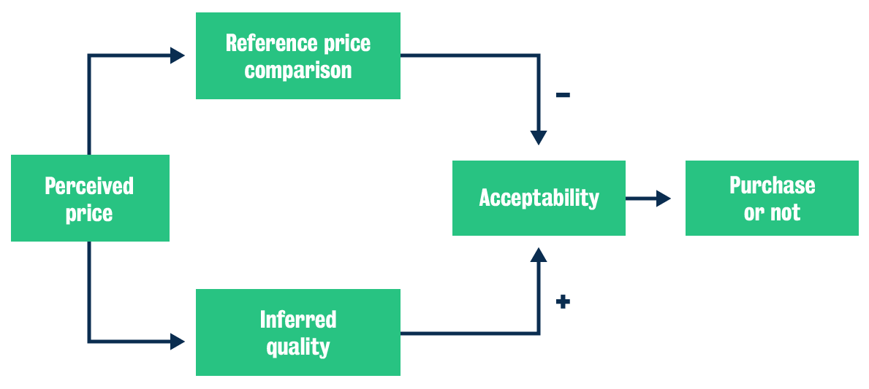
Week 9: Advertising & Response
5.2 Perceiving prices
Price Acceptability Decision model

Slide 17
Week 9: Advertising & Response
5.2 Perceiving prices
Price Acceptability Decision model
The Price Acceptability Decision model explains whether prices are perceived as acceptable or not. If the price increases, the acceptability is raised by the inferred quality, but also reduced by comparison to the reference price. For instance, if the price of a product like vitamins decreases, the acceptability is raised by the comparison with the reference price (the last price the customer paid for those vitamins). However, the inferred quality reduces the acceptability because consumers wonder why they are reduced. Is it because they are close to expiring or maybe the shipment was damaged in some way?

Slide 18
Week 9: Advertising & Response
5.3 Price promotion
As marketers providing a price promotion to consumers, our ideal carryover effect would be that our sales increase during the price promotion and maintain the increase over time when compared to our sales before the promotion. However, there are other carryover effects we must consider as well. How can discounts harm brand equity? Why have promotions?
Let’s explore how price promotion can relate directly to what we have learned about consumer price perception.

Slide 19
Week 9: Advertising & Response
5.3 Price promotion
Carryover effects
There are three different ways that customers could respond after a price promotion period (eg discounts and coupons) is over:
No carryover effect: sales are the same before and after the promotion period.
Switching: sales after promotion are higher than prior to promotion.
Stockpiling/price reference erosion: sales are lower than prior to promotion.
Price promotions help switching consumers (or switchers) but they don't convert them into loyal buyers. In fact, five out of six promotions are unprofitable for the manufacturer (Totten and Block) and brand equity can be harmed.

Slide 20
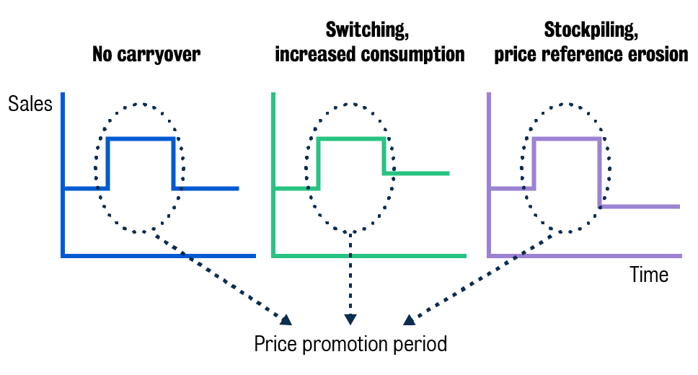
Week 9: Advertising & Response
5.3 Price promotion

Slide 21
Week 9: Advertising & Response
5.3 Price promotion
Why discounts might harm brand equity
Discounts may hurt brand equity because consumers’ reference price decreases and their perception of quality also decreases (price-quality heuristic). They may also associate negative attributes with the product, ie something is wrong with the product and therefore it is promoted. Studies have shown there can be negative long-term effects through the use of promotions and that sometimes there is a long-term expansion of the category, although this is rare. There is little evidence of a permanent effect on brand choice.
Why do companies have promotions, then?

Slide 22
Week 9: Advertising & Response
5.3 Price promotion
Let's have a look at some of the main reasons.
Promotions serve a retailer’s interest to attract customers
Promotions are a tool to drive traffic, for example, for a certain brand.
Store groups have the power and may insist on promotions
Big groups of retailers have considerable power and they can insist on promotions with manufacturers or suppliers. For instance, if a new brand wants to break into a big retailer such Tesco or Walmart, it is likely that the retailer would insist with the new brand to offer promotions on the new product so that they can drive traffic to the brand.

Slide 23
Week 9: Advertising & Response
5.3 Price promotion
Let's have a look at some of the main reasons.
Manufacturers may need the sales volume generated by switchers
Promotions generate manufacturers’ economies of scale within their production. It may also be a way for manufacturers to present themselves as a large company in order to have more power when dealing with large retailers. For example, Procter & Gamble or Unilever are big manufacturers of products and when they are dealing with Tesco or Walmart, they have a different relationship compared with the one the big retailers have with much smaller manufacturers.

